Slide 1


Slide 2
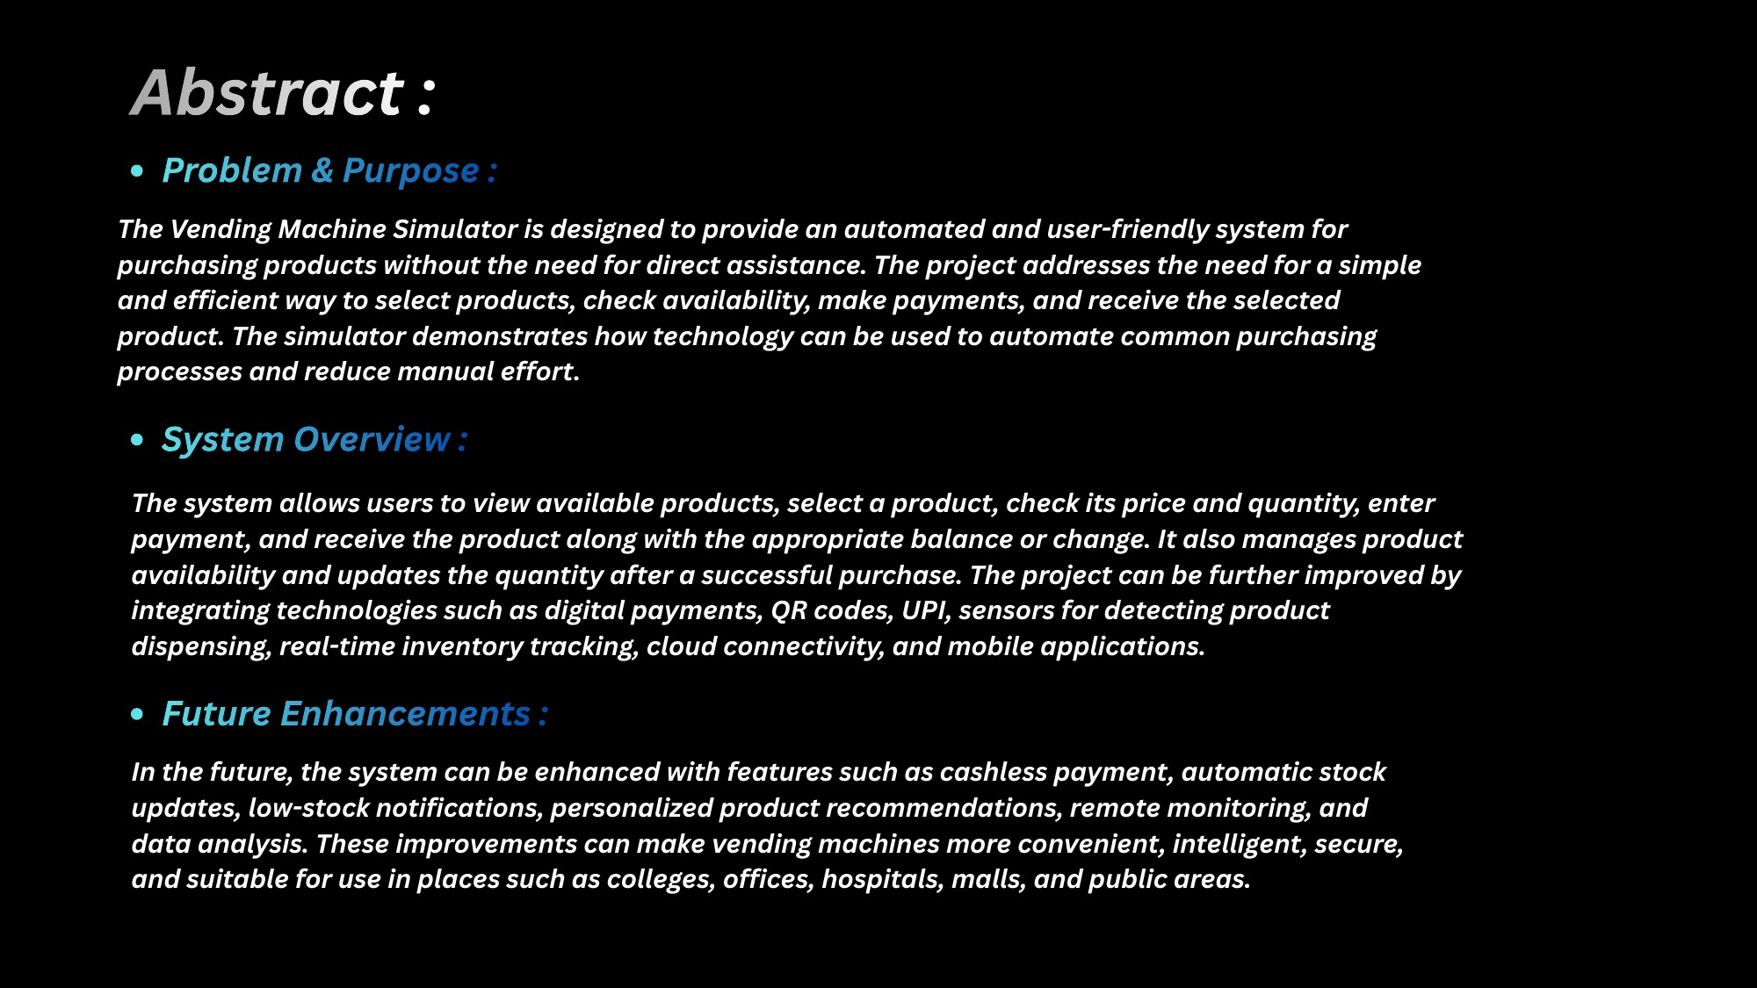

Slide 3
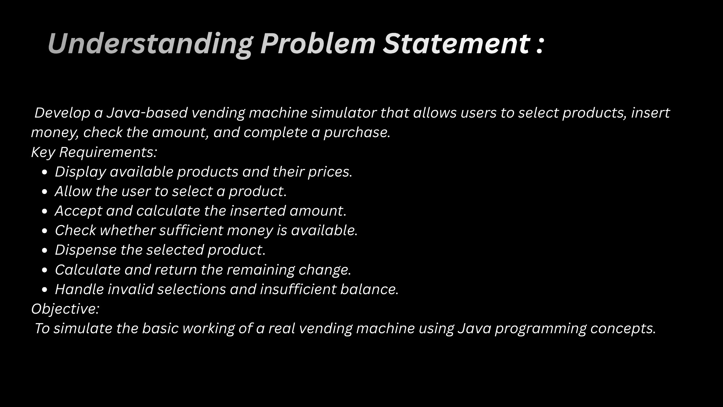

Slide 4


Slide 5
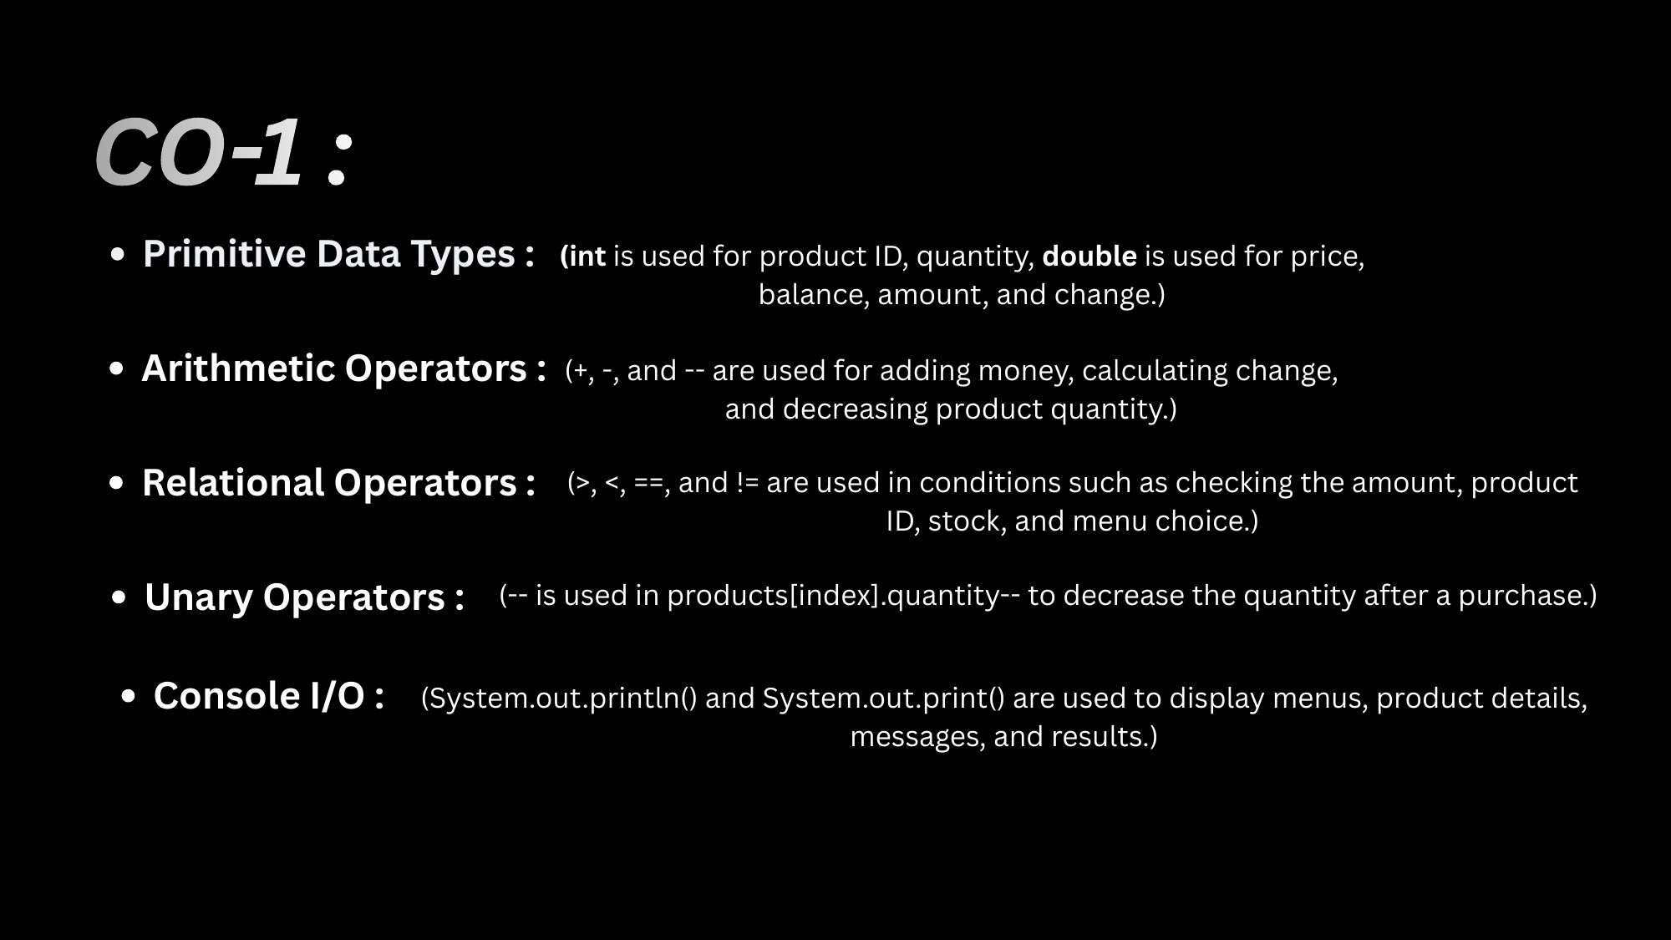

Slide 6
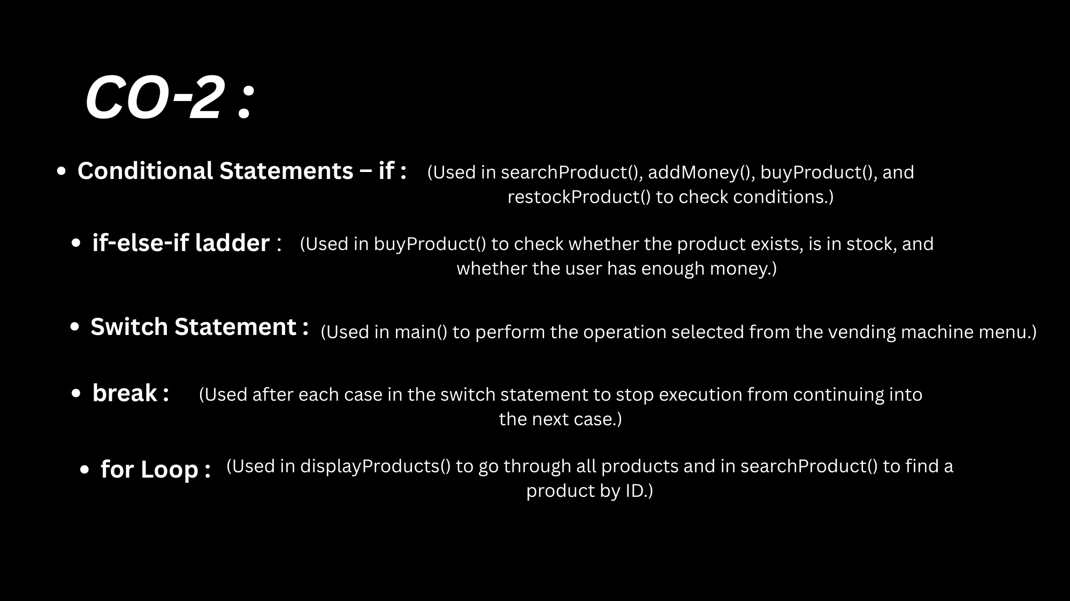

Slide 7
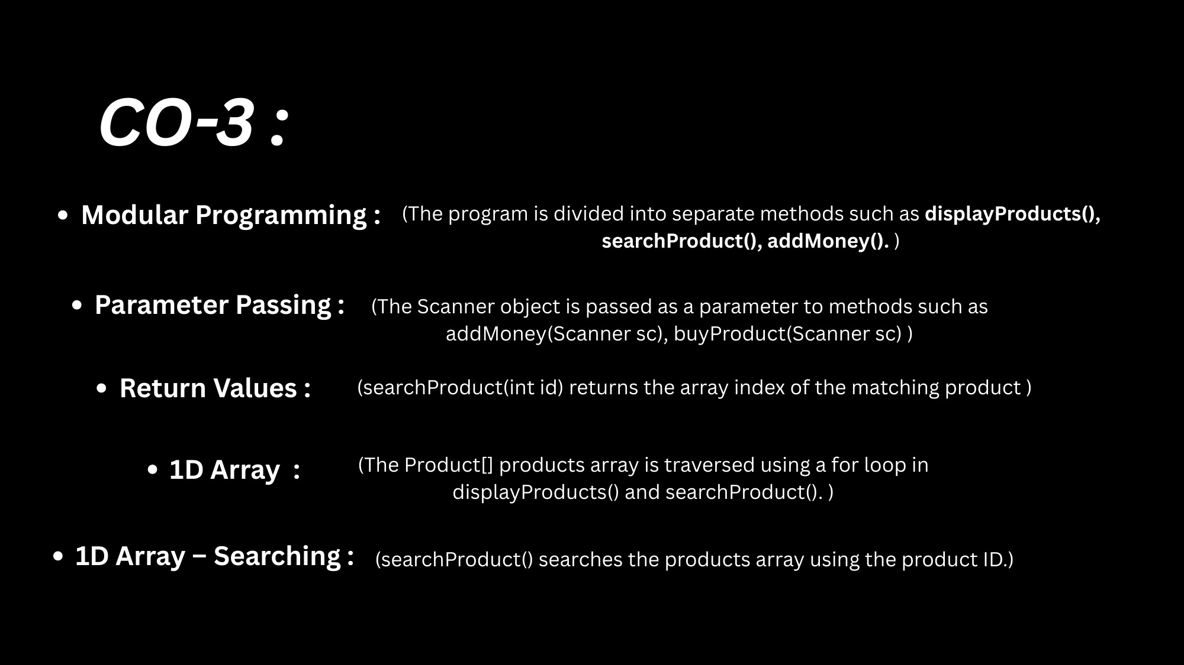

Slide 8
CO-4 :
Classes and Objects :
(The Product class is the blueprint; objects are created using new Product(101, "Chips", 20, 5) and stored in the products array.)
Constructor and this :
(The parameterized constructor Product(int id, String name, double price, int stock) uses this.id = id to set the fields.)
Encapsulation :
(id, name, price and stock are private fields, accessed through getters such as getId(), getPrice() and getStock().)
Static Members :
(sc, balance and products are static, and methods like viewProducts(), findProduct() and buyProduct() are static methods.)
toString() :
(System.out.println(p) prints the details of a Product object in viewProducts().)
Exception Handling :
(try-catch with NumberFormatException and Exception handles invalid menu choices, IDs and amounts.)

Slide 9
CO-5 :
String Concatenation :
(The + operator joins text and values in messages such as "Selected: " + p.getName().)
Parsing Input :
(sc.nextLine() reads typed text; Integer.parseInt() and Double.parseDouble() convert it into numbers.)
File Writing – Appending :
(savePurchase() uses FileWriter("purchase_history.txt", true) to append each purchase to the file.)
try-with-resources :
(The FileWriter is declared inside try( ) so it is closed automatically after writing.)
IOException Handling :
(catch (IOException e) displays a message if the purchase history cannot be saved.)

Slide 10
CO-6 :
Topics Used :
(Module 6 concepts such as Collections, Lambdas and Streams are not used in this version; products are stored in a 1D array.)
Future Scope – ArrayList :
(Replace Product[] with ArrayList<Product> to add or remove products without a fixed size.)
Future Scope – HashMap :
(Store products as Map<Integer, Product> for faster lookup by product ID.)
Future Scope – Streams :
(Use filter, map and collect on purchase history to generate sales reports and low-stock lists.)

Slide 11
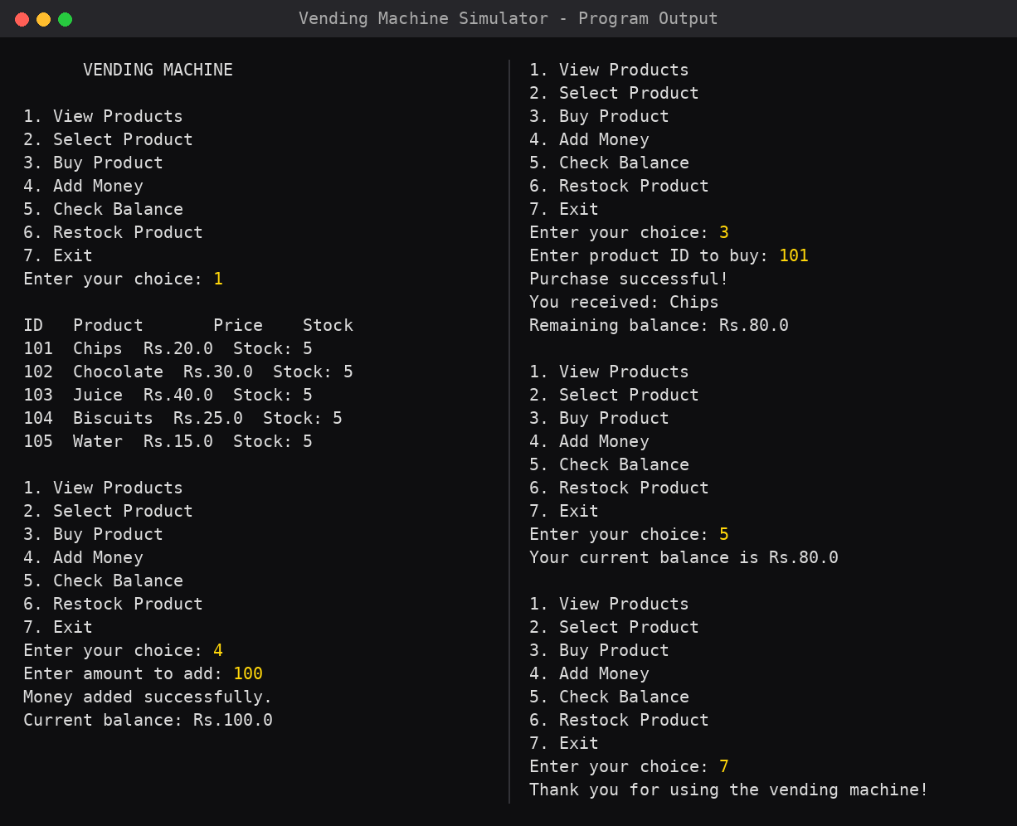
Output :
Sample run of the simulator: view products, add Rs.100, buy Chips (ID 101), check the balance (Rs.80) and exit.

Slide 12
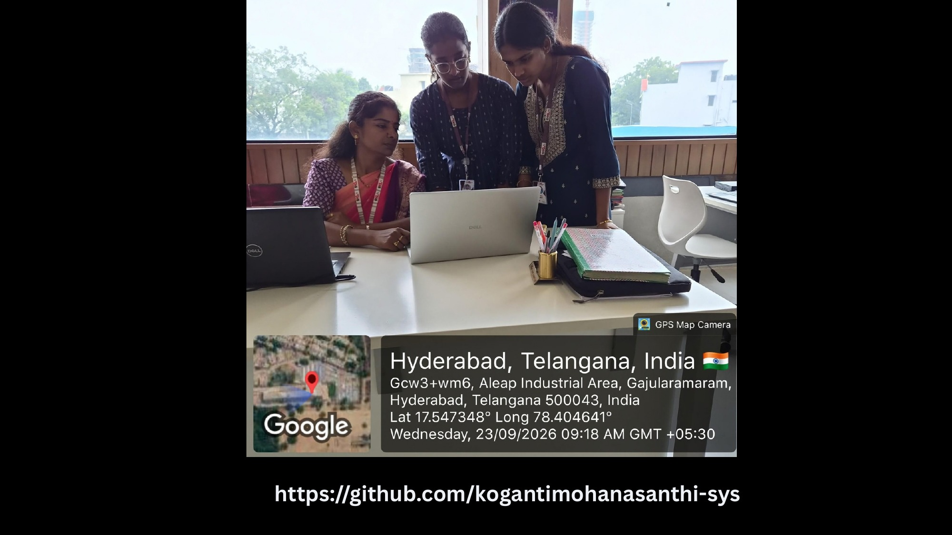

Slide 13


